Slide 1
Essential Drugs Programme
Pharmacy Week 2014
Kamohelo Moleli
12 September 2014

Slide 3
Various objectives toward same goal
To raise awareness on the profession
To create interest in the profession among the youth
To strengthen the relationship patient-pharmacist
To highlight the wide range of responsibilities within the profession
To reinforce the best practices from patients as well as service providers
For all to remember that pharmacists are not only dispensing medicines, they are providing a service
To promote Quality Pharmaceutical Service

Slide 4
Quality Pharmaceutical Service in essence means that:
The medicine the patient needs is available at all times
That the patient receives the best choice of medicine for his/her condition
Care is taken that the medicine does not harm the patient
Information about the medicine is readily available to the patient
The patient has the opportunity to talk about his/her medicine, ask the relevant questions, and is assured that his/her privacy is protected
Patients can give feedback about their experience in the pharmacy

Slide 6
A team work, at national level...
A theme for the year:
The theme “Towards Quality Care Together” is reinforced in 2014 Pharmacy Week with a concerted sub-theme focus that Antibiotics should be used wisely
Campaign aids
designed,
developed,
distributed to private and public pharmacies across the country,
and used by pharmacy personnel during Pharmacy week during their daily interactions with patients

Slide 7
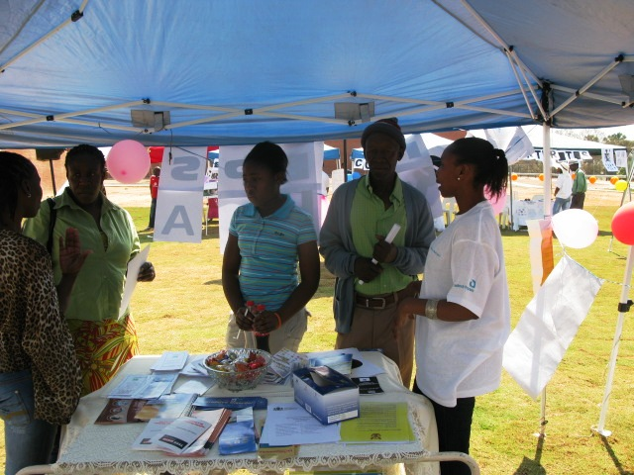
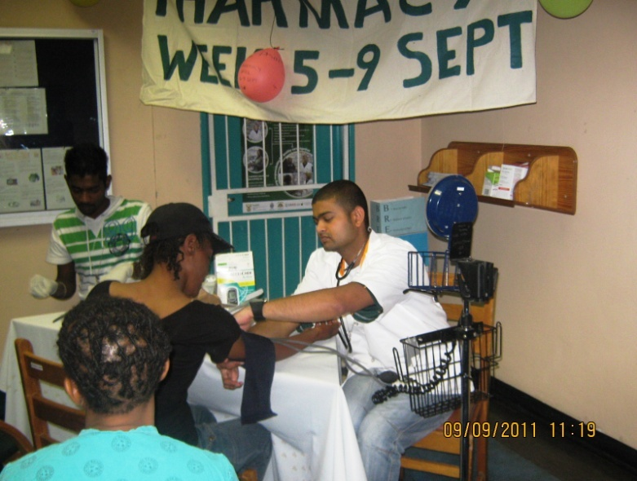
A team work, at facility level...
Community members in Mabopane, Gauteng were able to ask questions and gain more information on their health concerns
Patients presenting at the Kimberly Hospital Complex in the Northern Cape received health checks such as blood pressure, cholesterol and glucose

Slide 9
Antimicrobial resistance (AMR)
Major threat to the public health
Serious and growing global health risk
Direct threat to patient safety
Need to preserve antibiotics for future generation
The development and implementation of a national AMR strategy that complements international efforts is a major step towards containment of this growing threat.

Slide 10
Progress report
April 2014: Stakeholder Consultative meeting for development of the National AMR Strategy Framework document 2014 – 2024
May 2014: Presented at World Health Assembly (WHA) by Minister of Health (MOH)
June 2014: Circulated for comment to attendees of the consultative meeting
16 October 2014: AMR Summit in Gauteng

Slide 11
AMR Summit- Purpose
The purpose of the Summit is to bring together all stakeholders involved in work related to infectious diseases to advise on the organisational implications of the implementation of the Antimicrobial Resistance National Strategy Framework for South Africa

Slide 12
AMR Summit- Background
November 2014: WHO will convene a meeting of Member States, MOHs and other senior officials and experts in the field of responsible use of antimicrobials in Norway
To agree and commit to national objectives, strategies and effective interventions/actions that will help tackle AMR in their respective countries
To contribute to the international AMR agenda and inform the development of the AMR Global Action Plan
AMR Global Action Plan will be presented at WHA in Geneva in January 2015

Slide 13
AMR Summit- Objectives
Develop a comprehensive understanding of the Antimicrobial Resistance National Strategy Framework
Identify and agree upon feasible objectives and strategies to achieve responsible use of antimicrobials and to monitor trends

Slide 14
AMR Summit- Objectives
Obtain high level commitment from key stakeholders for investing relevant resources and implementing sound strategies and interventions to manage antimicrobial resistance, to limit further increases in resistant microbial infections, and improve patient outcomes
Agree on intersectoral collaboration activities
Public and private sector
Science & Technology, Agriculture, Education etc.

Slide 15
South African AMR Strategy
Pharmacy Week

Slide 16
Antibiotic resistance
Drivers
Overuse of antibiotics
Reliance on broad spectrum antibiotics
Acquisition of hospital-acquired infection
Interventions
AMR surveillance and reporting
Infection prevention and control
Appropriate use of antibiotics

Slide 17
Appropriate use of antibiotics
Optimising the use of antibiotics that are required
Reducing prescription of unnecessary antibiotics
USE ANTIBIOTICS WISELY

Slide 18
Pharmacy Week 2014 campaign
Theme: Use antibiotics wisely
Communication support: Posters and Flyers in 9 official South African languages

Slide 19
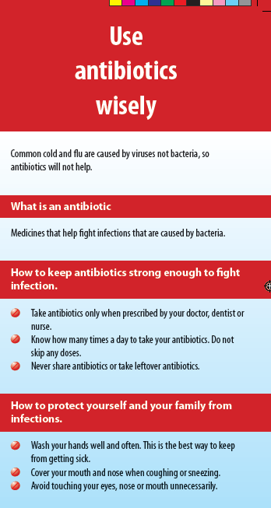
Pharmacy Week 2014

Slide 20
If the pharmacist and his/her patient work together, they can achieve the optimum pharmaceutical care results!

